Slide 1
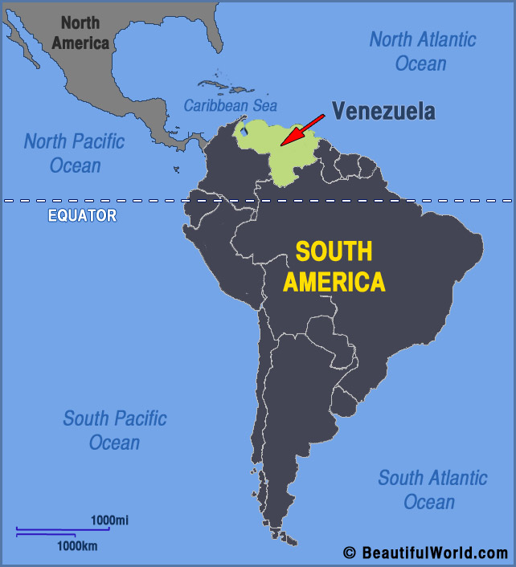

Slide 2
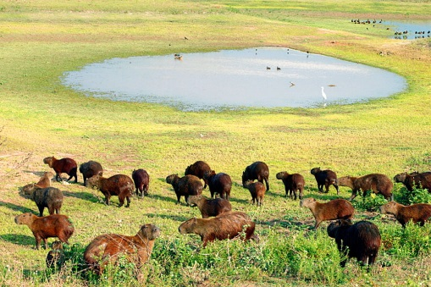
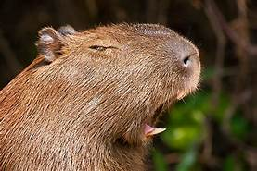
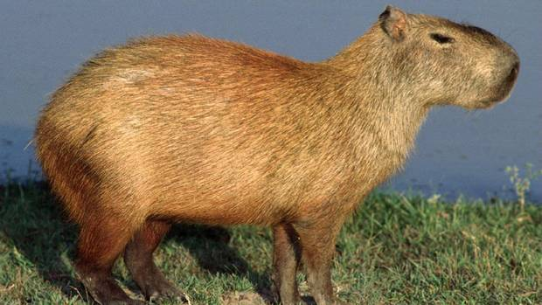
Venezuela is famous for its fantastic wildlife, and many people visit this country to see animals like the capybara in their habitat.

Slide 3
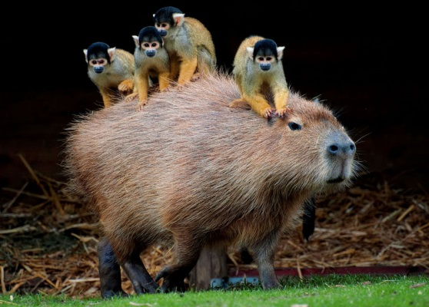
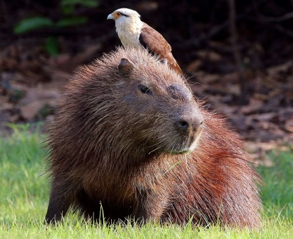
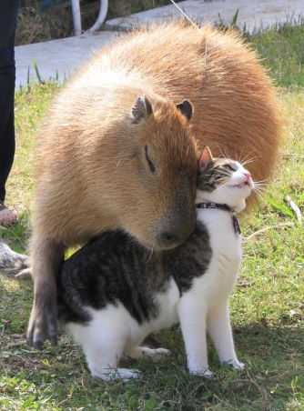
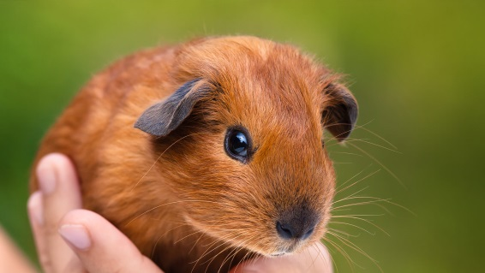
Capybaras are a type of guinea pig.
Lots of children have guinea pigs as pets, but capybaras are wild animals and they’re a lot bigger than guinea pigs.

Slide 4
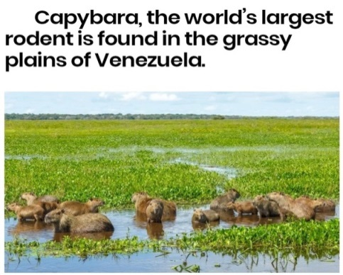
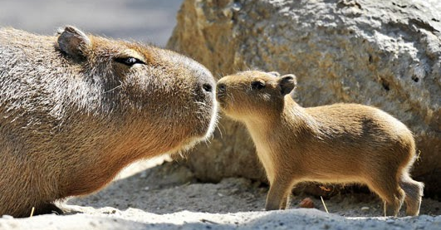
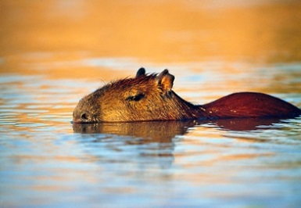
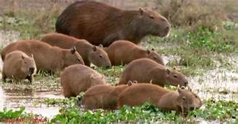
Capybaras usually live in groups of ten to thirty. They live near rivers, and they’re excellent swimmers— they can swim under water for up to five minutes!

Slide 5
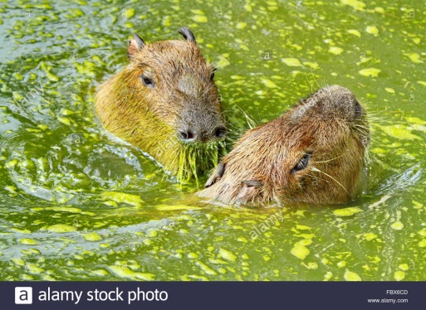
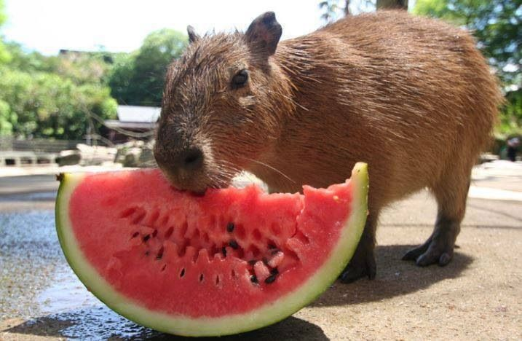
Capybaras like swimming in the day and eating at night. They’re herbivores. They eat grass and plants from the water, but they don’t eat any meat.

